Slide 1
Project Access San Diego Referral Coordinator Guide

Slide 2
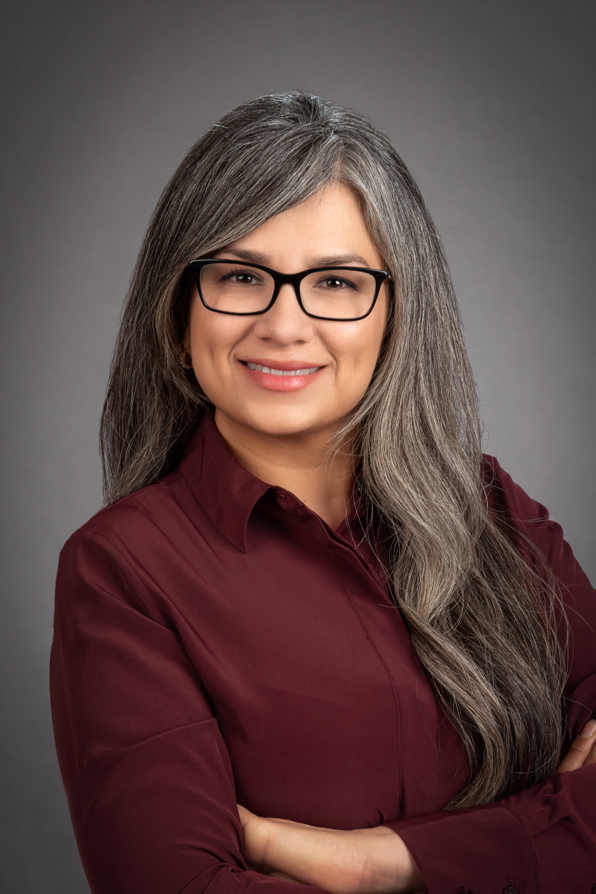
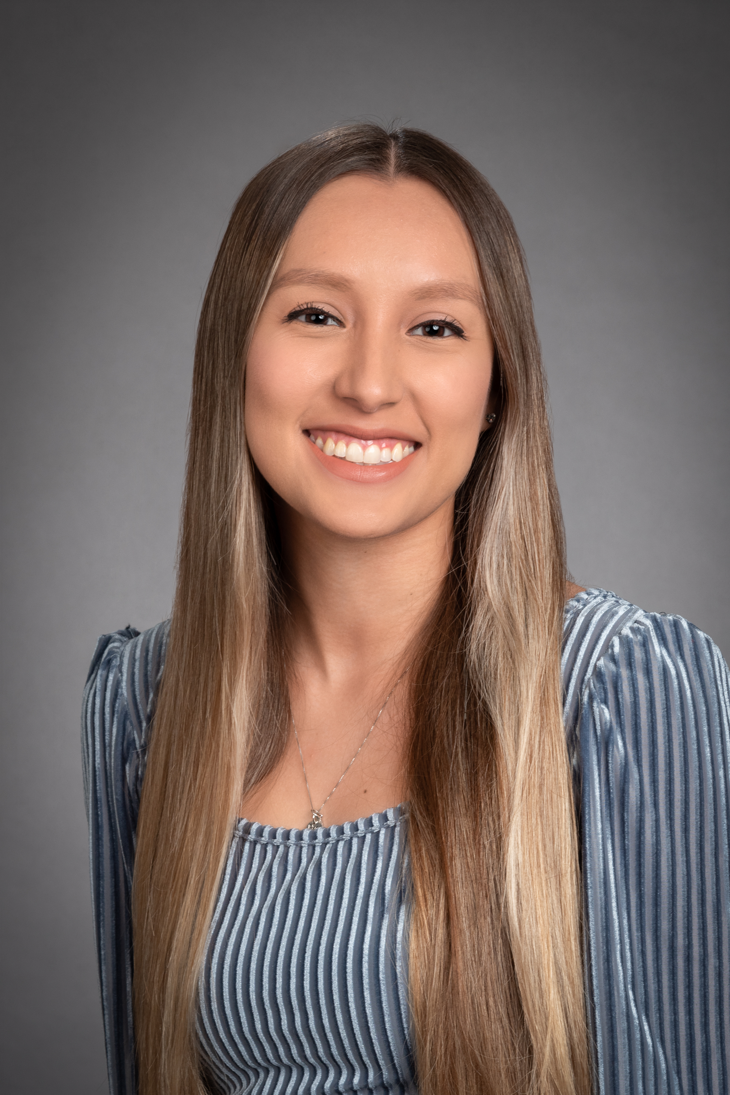
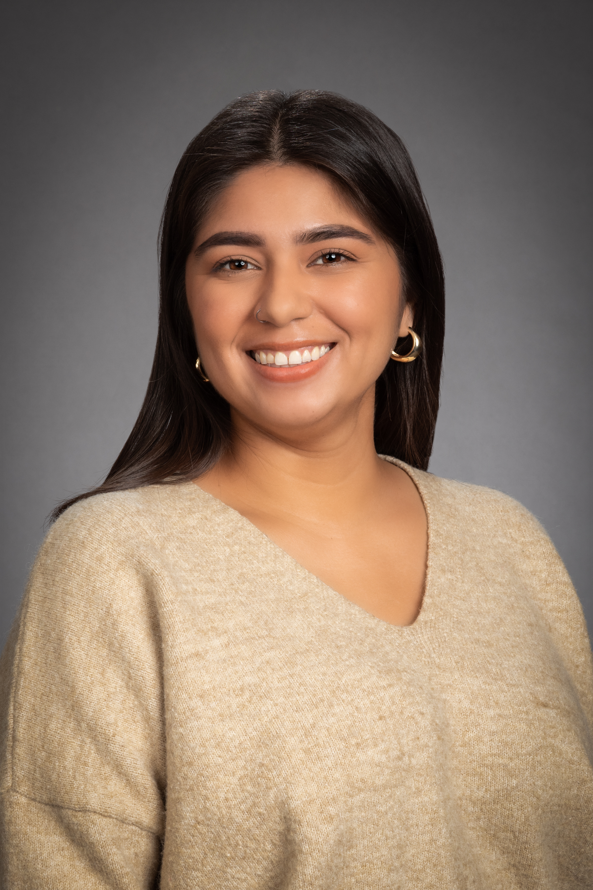
Project Access San Diego Team
Celene Salazar
Evelyn Damanhoury
Desseray Reyes
PASD Program Manager
General Surgery
PASD Care Manager
Ophthalmology/Retina
GYN
PASD Care Manager
Cardiology
GI

Slide 3
Who we are
Project Access San Diego is the flagship program for the San Diego County Medical Society Foundation.
At the heart of the program are volunteer physicians and other healthcare providers who assist patients that cannot afford medical services and do not have insurance nor qualify for public health insurance programs.
Project Access has a network of volunteer physicians, hospitals and ancillary services that provide full range of healthcare at no charge to low-income and uninsured residents of San Diego County.
Project Access San Diego is modeled after other successful programs being implemented in 50 cities around the country.

Slide 4
What we do
Increase access to health care for the medically underserved by linking low-income, uninsured San Diegans with free health care services.
Patients are screened for eligibility by PASD Care Managers with CMO oversight to ensure that patients are medically appropriate.
Provides enabling services such as transportation and interpretation.
Provides access to the full continuum of care through arrangements with hospitals, ancillary service providers, etc.
Patients can receive help with prescriptions depending on medication cost, frequency needed, and our budget. Patients must follow PASD pharmacy guidelines and will only be covered for rx written by volunteer physician.
We also look for Patient Assistance Programs to help with prescriptions.

Slide 5
How PASD works
Identify patients from community clinics that need specialty care or outpatient surgery to enroll in PASD.
Fax referral form, COMPLETED enrollment application, medical records, copy of ID, proof of residency in San Diego County (if different from address on ID) and income.
Cases are reviewed by care managers and the medical director weekly, cases are accepted or returned for more information, or denied if out of our scope or other reason.
Patients will be initially enrolled for six months.
Patients will receive case management and returned to their medical home for regular care.

Slide 6
Appropriate patients for PASD
Health care needs of limited scope/duration
Examples:
Needs one specialist consultation to help determine a diagnosis or to provide a treatment recommendation to the primary physician
Needs a single test (MRI or CT scan)
Needs an outpatient surgery (gallbladder removal, biopsy, hernia repair)
NOT appropriate:
Examples:
Known cancer patient
Chronic disease/condition management
Chronic pain patient for ongoing care (single consult with one follow up ok)
End stage disease of any type for ongoing care (single consult for treatment plan ok)
Notes:
Give examples of on going care: Arthritis, thyroid disease,

Slide 7
Eligibility Requirements
PASD referral guidelines must be satisfied:
Patient must earn less than 322% of the Federal Poverty Level.
Patient must be living in San Diego County.
Patient must not have any health insurance or Workers’ Compensation coverage.
Patient must be ineligible for any publicly sponsored programs including Medi-Cal, Medicare or Covered California.
Patient must agree to follow PASD Rights and Responsibilities.

Slide 8
Referral Guidelines
Please review referral guidelines with the referring physician PRIOR to submission to ensure that guidelines have been met.
SAMPLE REFERRAL GUIDELINE
Criteria for Referral: CHOLECYSTECTOMY:
History (any one of 3)
History of Jaundice
Two or more documented episodes of abdominal colic or severe RUQ pain
The presence of nausea/vomiting, chills and fever, leukocytosis (if evidence of infection, consider immediate hospitalization outside the purview of PASD)
Diagnostic Tests
Ultrasound or CT scan documents presence of gallstone

Slide 9
Referral Guidelines (continued)
The following medical notes are required for ALL referrals:
Last three office consults relevant to dx (if applicable)
Related labs
Related imaging and diagnostic reports
Relevant emergency room, hospital and consultant reports (if applicable)

Slide 10
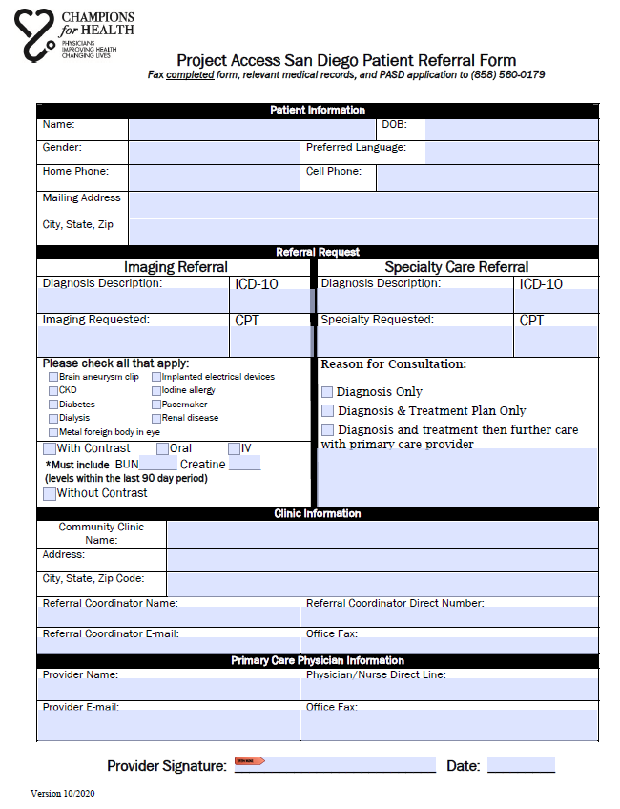
Patient Referral Form
The referral form is available on our website www.championsforhealth.org
Patient Referral Form to be completed by referring physician or referral manager
Please include referral coordinator information and PCP signature!

Slide 11
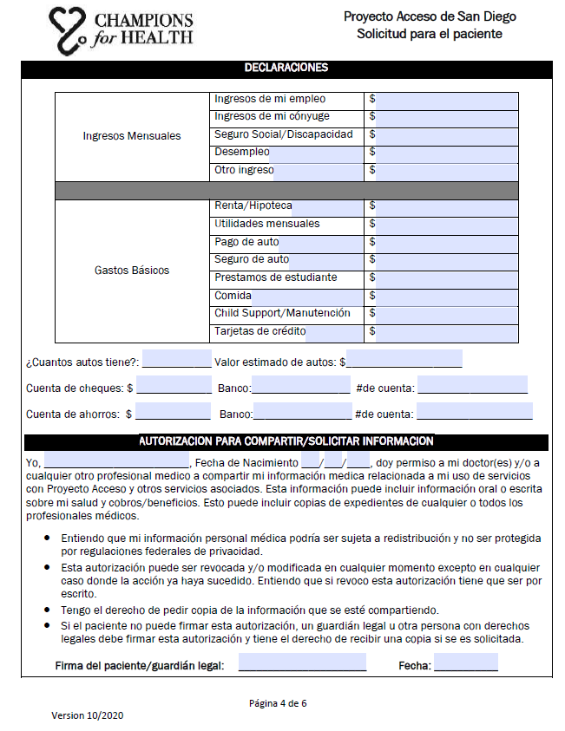
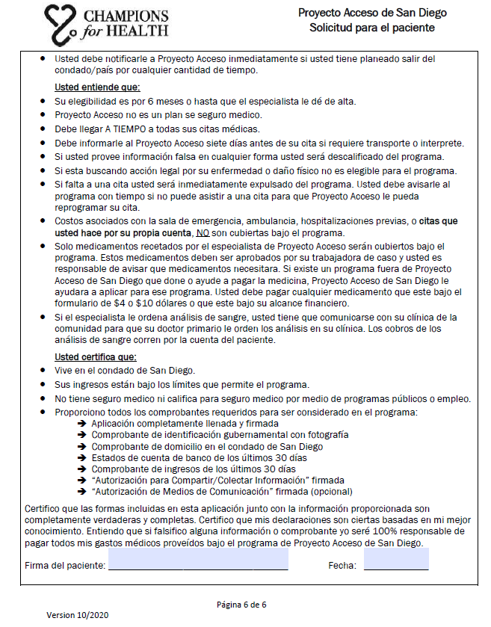
Patient Application
Patient must sign the application and agree to the following conditions
Patients who miss an appointment will be expelled from the program & will be ineligible to reapply.
Applications without signatures will be considered incomplete and will not be processed.

Slide 12
Application Packet Checklist
The following items must be submitted to PASD for consideration:
Complete and signed patient enrollment form (6 total pages)
Copy of picture I.D
Proof of living in San Diego County (bills/statements) – ONLY IF ADDRESS IS DIFFERENT THAN WHAT IS ON THEIR ID
Proof of income
PASD referral form completed and signed by the referring physician
Patient medical records
Notice of Action from Medi-Cal (if applicable)
PLEASE ENSURE THAT ALL REFERRAL GUIDELINES ARE SATISFIED.
INCOMPLETE SUBMISSIONS WILL NOT BE CONSIDERED!

Slide 13
Referral Communication
Patient referrals are received on a secure, dedicated fax line at PASD (858) 560-0179.
You can call or email to confirm we received it ☺
PASD care manager reviews application and supporting documents for completeness.
If a referral is sent back as pending because it is missing something please make sure to re-fax the complete referral again, not just what was missing.
PASD CMO and care managers review cases on a weekly basis. PASD notifies clinics by fax, if the patient has been accepted or denied. If patient is denied you will be provided with a denial reason.
Notice of Action (NOA) is sent to the fax on the PASD referral form so please ensure that the fax number you provide is the accurate fax number.
Please do not distribute PASD phone numbers to prospective PASD patients.
PASD care manager will contact the patient after the patient has been accepted into the program.
Notes:
Clinics will be provided with a status update for each patient submitted.
Ensure that proper fax number is on referral form submitted to PASD
Please do not give PASD phone number to patients to inquire about the status of their case

Slide 14
Referral Communication (continued)
Three attempts will be made (one phone call per business day) to contact the patient at the telephone numbers listed on the application. If the patient does not return the phone call within 3 business days from the last attempt, the patient is not appropriate for PASD and will not be enrolled in the program.
PASD care manager will schedule all appointments and will do reminder calls to the patient.
Only appointments scheduled by PASD will be covered by the program.
Scheduling an appointment may take a few days to a few weeks depending on resources and specialties available for that month.
You can always contact us for an update on scheduling but notes will be sent after patient is graduated.

Slide 15
Common Delays in Referral Process
Referral is set to pending and missing document is faxed on it’s own
PASD referral page does not have provider signature
Ok if on clinic referral form
Missing relevant notes, imaging, and/or labs

Slide 16
Patient Responsibilities
Be on time for all appointments.
Notify PASD care manager if transportation or interpretation services are needed.
Be respectful of the healthcare provider and staff.

